Slide 1
Local Transportation Commission Regional Transportation Plan (RTP) workshop
Overview and Purpose of the Regional Transportation Plan
Provide a clear vision of the regional transportation goals, policies, objectives and strategies for the Regional Transportation Planning Agencies (RTPAs)
Provide an assessment of the current modes of transportation and the potential of new travel options within the region.
Identify and document specific actions necessary to address the region’s mobility and accessibility needs.
For Mono Co, serves two purposes as required by state law – Regional Transportation Planning Agency (RTPA or LTC) and the circulation element of the General Plan – one document for both
RTP is linked with TOML & Mono Co Housing Elements
CA Transportation Commission is updating RTP Guidelines

Slide 2
Regional Transportation Plan Workshop
Regional Transportation Plan – Elements
1) Planning Process
2) Needs Assessment
3) Regional Policy Element
4) Community Policy Element
5) Action Element
6) Financial Element

Slide 3
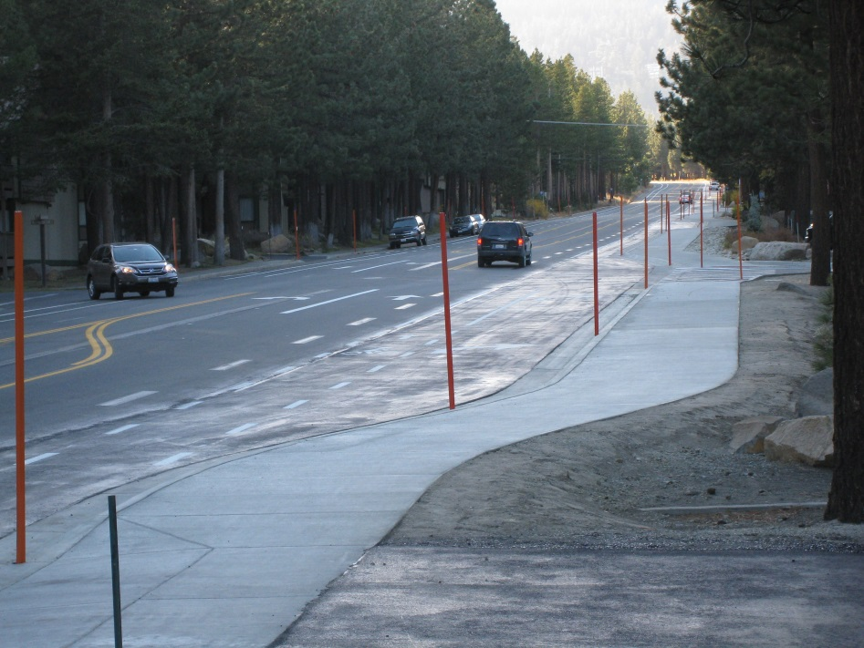
Regional Transportation Plan Workshop
3) Regional Policy Element – Goals, Policies and Objectives for the following areas:
Land use issues
Economic factors
Resource Efficiency
Environmental issues
Livable communities
Operational Improvements
Non-motorized transportation (ATP)
Transit
Parking
Aviation
Plan Consistency
Public Participation
Performance Measures (STIP, Rural Performance Measures, Qualitative vs. Quantitative, Asset Management/SWITRS)

Slide 4
Regional Transportation Plan Workshop
4) Community Policy Elements - review with communities for any updates
Antelope Valley
Swauger Creek/Devils Gate
Bridgeport Valley
Bodie Hills
Mono Basin
Yosemite
June Lake
Mammoth Vicinity/Upper Owens
Long Valley
Wheeler Crest
Paradise
Tri-Valley
Oasis
Town of Mammoth Lakes – Mobility Element

Slide 5
Regional Transportation Plan Workshop
5) Action Element
2024 Regional Transportation Improvement Program
6) Financial Element
2024 RTIP and data updates (tables)

Slide 6
Regional Transportation Plan Workshop
What happens next?
RTP update
coincide with the 2024 Regional Transportation Improvement Program,
CTC updating guidelines
update any community policies, and
any technical corrections
Comments/Questions?

