Slide 1
State Transportation Improvement Program STIP Workshop
Overview transportation funding (non transit)
Project development
Focus STIP / RTIP program
Town RTIP & County RTIP
Next steps
CTC Town Hall, Partnerships in the Eastern Sierra, September 13 & 14
Notes:
Good morning – Gerry LeFrancois, Mono County LTC

Slide 2
Transportation Funding
SB 1 Road Repair and Accountability Act 2017
SB 1 is a landmark transportation investment in California. increasing transportation funding and instituting much-needed reforms. SB 1 provides the first significant, stable, and on-going increase in state transportation funding by fixing neighborhood streets, freeways and bridges in communities across California and targeting funds toward transit and congested trade and commute corridor improvements. Maintenance and Rehabilitation of the State Highway System
Repairs to Local Streets and Roads - SB 1 dedicated approximately $1.5 billion per year in new formula revenues apportioned by the State Controller to cities and counties for basic road maintenance, rehabilitation, and critical safety projects on the local streets and roads system (Road Maintenance Rehabilitation Account -RMRA).
Maintaining and Repairing the State’s Bridges and Culverts

Slide 3
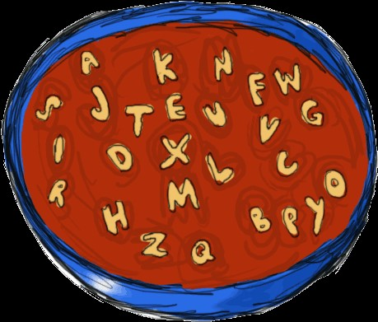
Funding
SB 1 continued
New Funding to Transit Agencies
Trade Corridor Enhancement Program (TCEP)
Solutions for Congested Corridors Program (SCCP)
Active Transportation Program (ATP)
Matching Funds for Local Agencies
Local Planning Grants
Infrastructure Investment & Jobs Act (IIJA also BIL) and other grants
Local Highway Safety Improvement Program (HSIP), Promoting Resilient, Operations for Transformative, Efficient, and Cost Saving Transportation (PROTECT) Program, Safe Routes to Schools (Fed – SRTS & State-SR2S)
Other regular sources – annually, bi annually, and/or competitive
Federal Lands Access Program (FLAP) - competitive
Highway Safety Improvement Program (HSIP) – highways, bridges, local roads
Regional Surface Transportation Program (RSTP) - annual
State Transportation Improvement Program (STIP) – mix of SB1 and federal sources

Slide 4
Funding - STIP
STIP – every 2 years
The STIP funds new construction / rehabilitation projects on the transportation network. STIP consists of two components, Caltrans’ Interregional Transportation Improvement Program (ITIP) and regional transportation planning agencies’ Regional Transportation Improvement Program (RTIP). STIP funding is a mix of State, federal, and local taxes and fees.

Slide 5
Funding - STIP
STIP – every 2 years
STIP Chart 5 – Transportation Funding in CA 2020
Interregional Transportation Improvement Program (ITIP) – 25%
Regional Transportation Improvement Program (RTIP) – 75%
North/South split = North counties – 40% / South counties 60%
County share – Population 75% and State Hwy mileage 25%

Slide 7
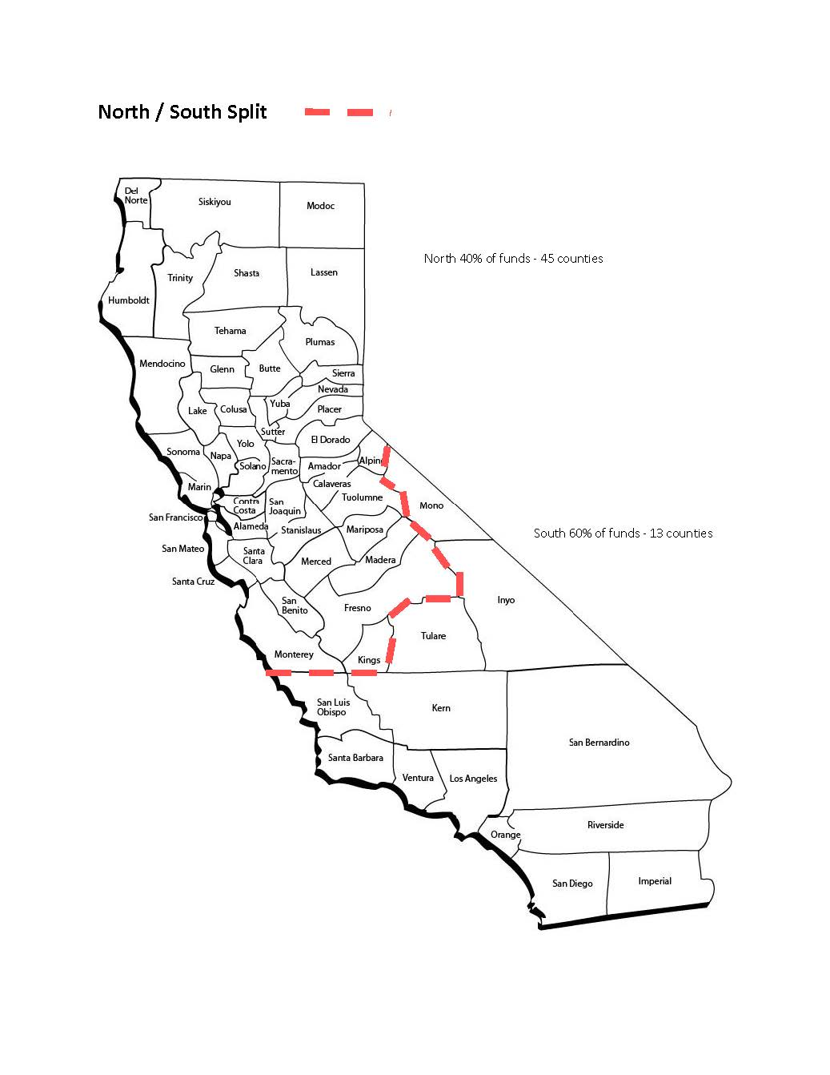

Slide 8
Project Identification & Development
Project(s) identified via:
Regional Transportation Plan (RTP)
Capital Improvement Programs (CIP)
Pavement Management Systems (PMS)
Special traffic / transportation studies – Project Initiation Documents (PIDs) and Project Study Reports (PSRs,
Community input (LTC, RPACs, CAC, PAED Commission, etc.)
Project Development
Is funding eligible for the project and what type of funds?
PA ED – Planning Approval & Environmental Document
PSE – Plans, Specifications, and Estimates
ROW – Right of Way
CONST - Construction

Slide 9
STIP & RTIP
STIP - The STIP is the state wide multi-year capital improvement program of transportation projects on and off the State Highway System, funded with revenues from the Transportation Investment Fund, SB 1 and other funding sources . STIP programming occurs every two years (2020, 2022, 2024, etc.).
RTIP – Regional Transportation Improvement Program is our local program of projects under the STIP. The 58 county RTIPs make up the STIP. Staff is responsible for proposing and advancing projects, and the Commission adopts the RTIP for submission to the State.

Slide 10
STIP & RTIP
RTIP – coordinated effort between TOML and Mono County
Share balances over last 10 years or 5 STIP cycles:
2014 – $6.52 million
2016 – negative
2018 – $8.24 million
2020 – $3.41 million
2021 Federal Coronavirus Response & Relief Supplemental Appropriation Act – 2021 (CRRSAA) - $1.3 million
2022 – $5.12 million
Shares = dollars with this years amount $ 9.2 million

Slide 11
Town & County Potential Projects

Slide 12
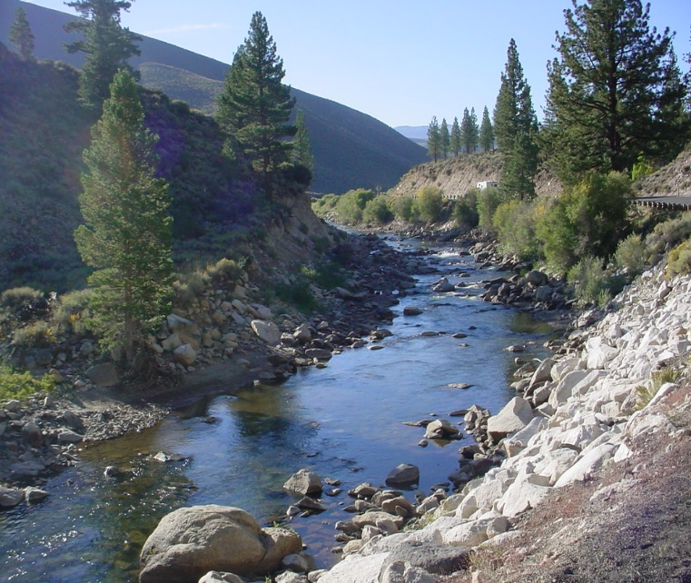
Next Steps & Questions
Staff will work on finalizing possible projects
Commission consideration & adoption at the November 13, meeting
Mono County LTC RTIP is due to State on December 15
Questions of staff

