Slide 1
Wildfire Management Plans and Policies: USFS and BLM
Lance Rosen – Deputy Interagency Fire Management Officer
Chance Traub – Fire Management Specialist (Fuels and Prescribed Fire)
Notes:
Thank, Eastern Sierra Councils of Government and Eastern Sierra Wildfire Alliance for Organizing these sessions on Wildland Fire.
Wildland Fire Management Plans and Policies: USFS and BLM
Chance Traub – Fire Management Specialist For the Inyo NF
Lance

Slide 2
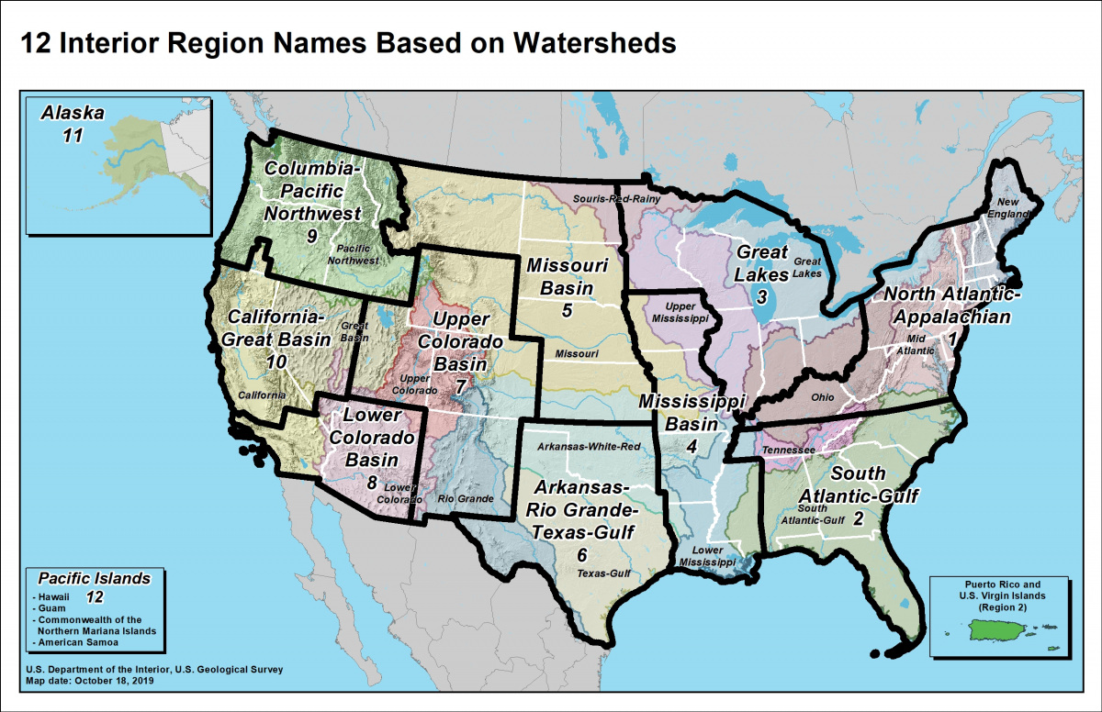
Department of the Interior Regions: Bureau of Land Management (BLM) National Park Service (NPS) Bureau of Indian Affairs (BIA) US Fish and Wildlife Service (FWS)

Slide 3
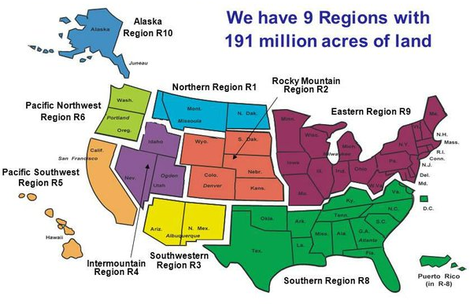
The Forest Service Regions

Slide 4
Land Management Agency’s Wildland Fire Work Force
Federal Wildland Fire Fighters (Total): 15,000
Department of Interior – 5,000 Wildland Fire Fighters
Bureau of Land Management
US Fish and Wildlife Service
National Park Service
Bureau of Indian Affairs
US Department of Agriculture – 10,000 Wildland Fire Fighters
United States Forest Service

Slide 5
Inyo NF and Bishop BLM Interagency Fire Management Program.
Inyo National Forest: 1,903,381 acres
Bishop BLM Field Office: 750,000 acres
Counties covered: Fresno, Inyo, Mono, and Tulare Counties, California;
Esmeralda and Mineral Counties, Nevada

Slide 6
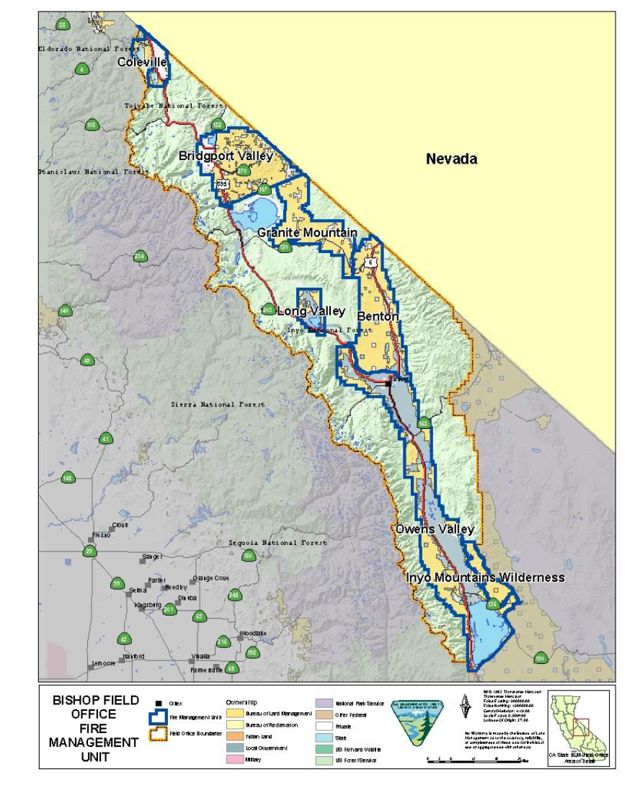
Bishop Field Office
Fire Management Unit

Slide 7
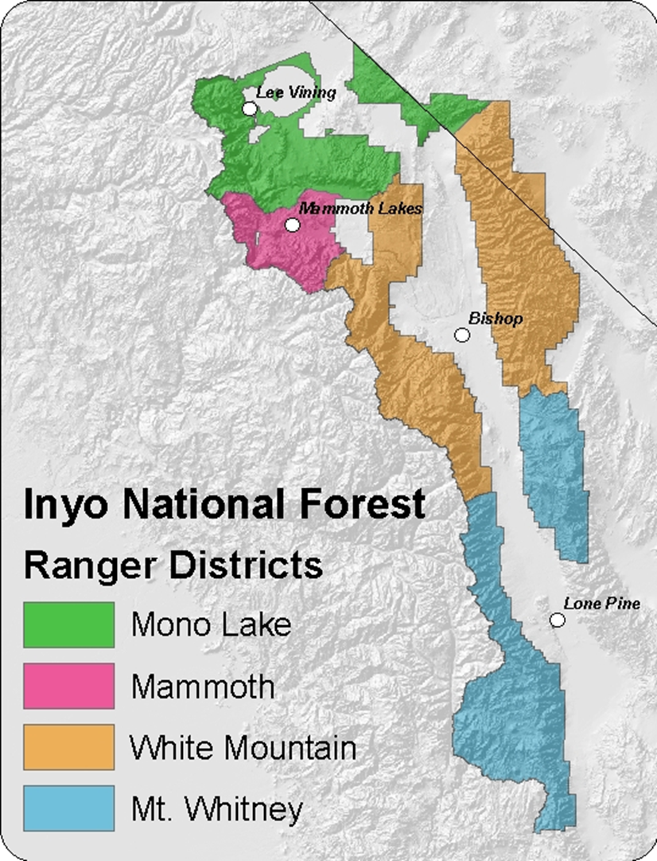
Inyo National Forest Ranger Districts

Slide 8
How is Wildfire Management Plans and Policies tied to actions on the ground.
National Fire Policy
1995/2001 Federal Wildland Fire Management Policy
Federal Land Assistance, Management, and Enhancement Act (FLAME) of 2009
Agency Specific Policies and Strategies
DOI Regional Policy
FS Regional Policy
Forest Policy: Land Management Plan
District Policy
Field Office: Fire Management Plan
USFS 10 Year Wildfire Crisis Strategy
National Cohesive Wildland Fire Management Strategy
Interagency Standards for Fire and Fire Aviation Operations

Slide 9
Federal Fire Policy: Wildland Fire Definitions and Guidance
Wildland fires - Any non-structure fire that occurs in vegetation or natural fuels. They can be categorized into two distinct types:
Wildfires – Unplanned ignitions or prescribed fires that are declared wildfires.
Human Caused Ignitions: Unauthorized and accidental human caused fires, and prescribed fires that are declared wildfires.
Initial action on human-caused wildfire will be to suppress the fire at the lowest cost with the fewest negative consequences with respect to firefighter and public safety.
Natural Ignition: Lightning, and volcanos.
A wildland fire may be concurrently managed for one or more objectives and objectives can change as the fire spreads across the landscape. Objectives are affected by changes in fuels, weather, topography; varying social understanding and tolerance; and involvement of other governmental jurisdictions having different missions and objectives.
Prescribed Fires – Planned ignitions
A wildland fire originating from a planned ignition in accordance with applicable laws, policies, and regulations to meet specific objectives.
Federal Wildland Fire Management Policy and Doctrine Overview (Chapter 1)

Slide 10
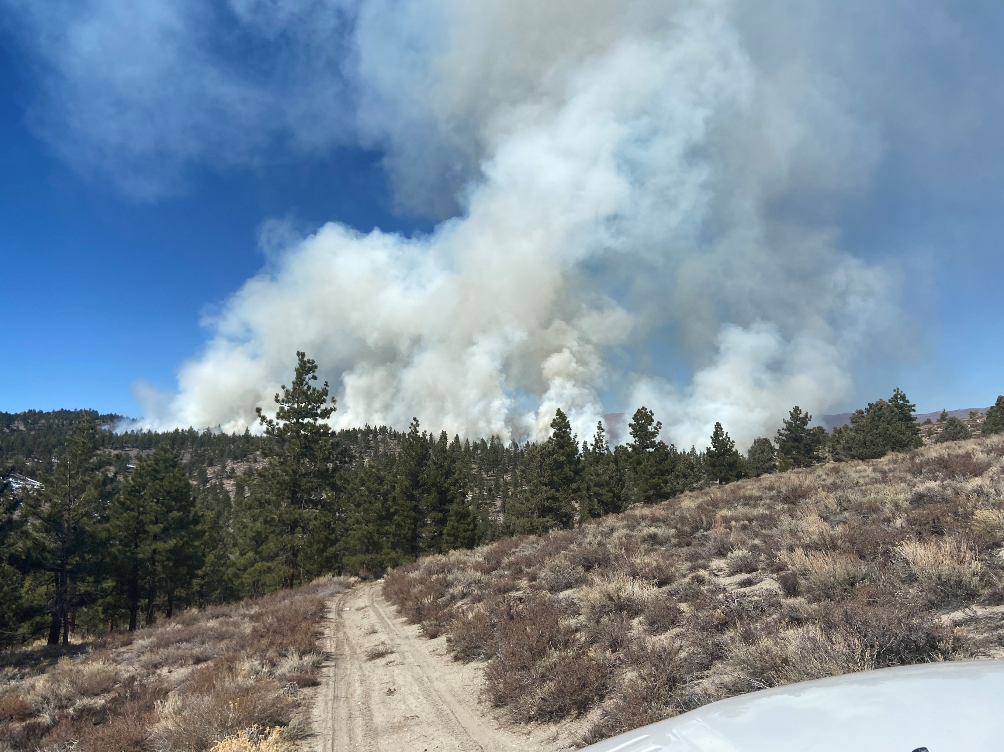
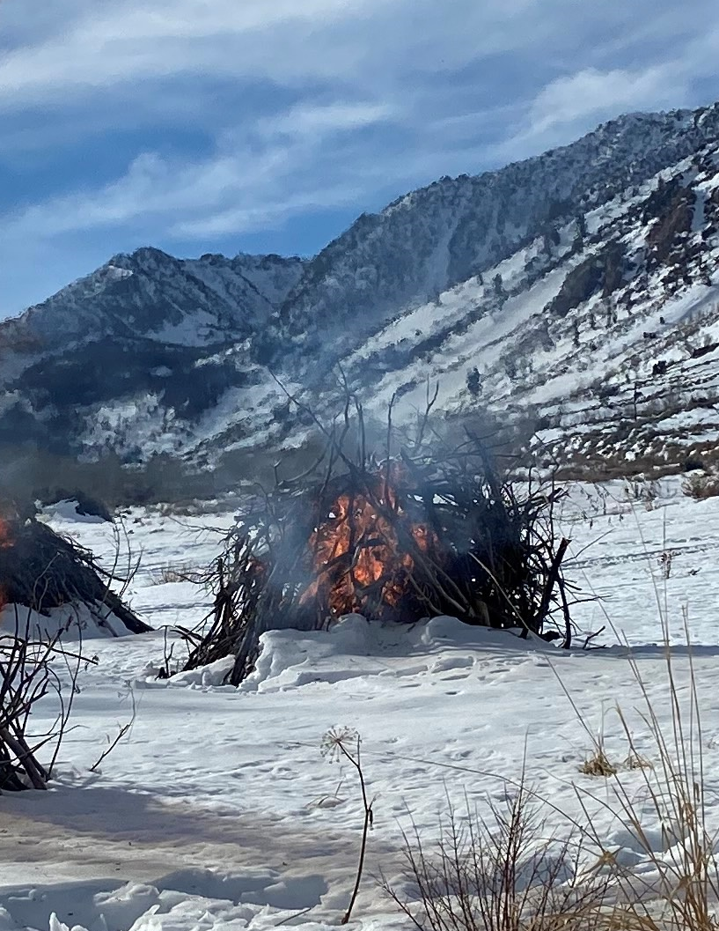
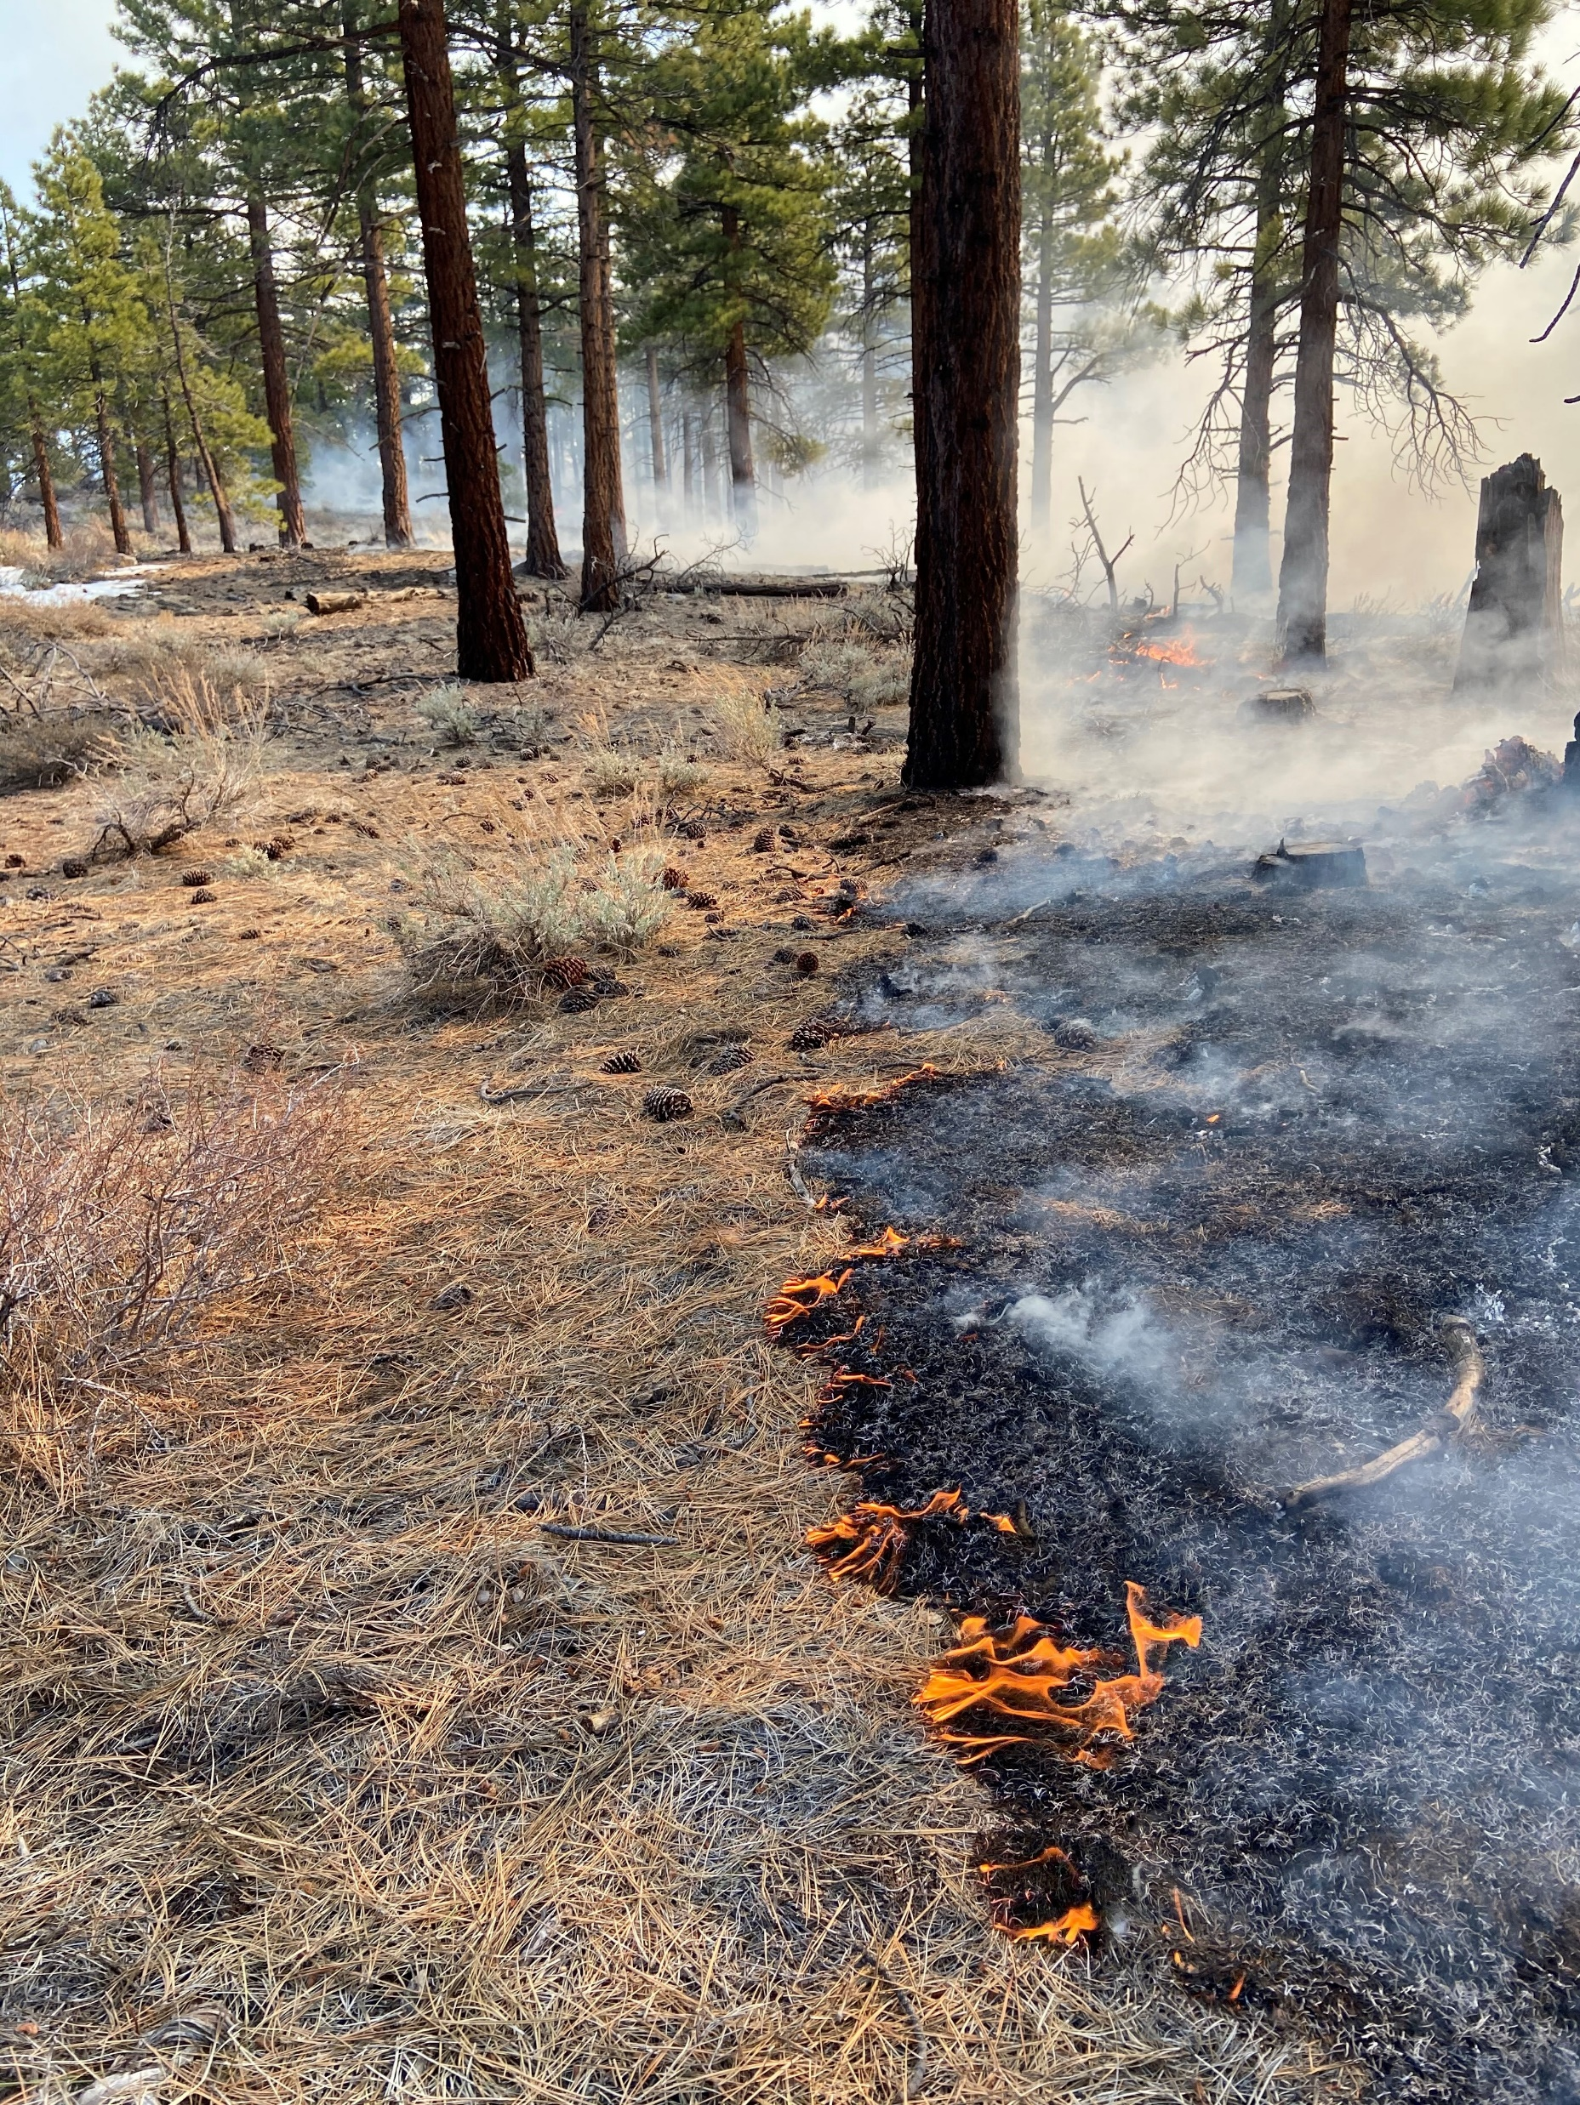
Planned Ignitions Prescribed Fire A wildland fire originating from a planned ignition in accordance with applicable laws, policies, and regulations to meet specific objectives.
Broad Cast Burning
Pile Burning

Slide 11
Bishop Field Office
Fire Management Unit

Slide 12
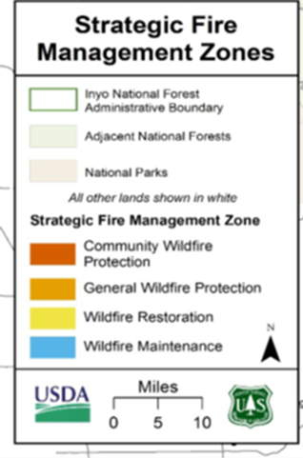
Inyo N.F. Strategic Fire Management Zones
“The purpose of strategic fire management zones is to support decisionmakers before a fire ignition occurs, by pre-assessing the risk and benefits from wildland fire (both wildfire and prescribed fire) to areas on the landscape. (LMP 2019)”
“Forest plan guidance aids wildland fire management decisions to meet the full range of forest plan objectives and use the most appropriate wildfire response within all the zones. (LMP 2019)”
“The entire spectrum of strategies is available in all the zones and wildland fires will be actively managed in all the zones to meet objectives. (LMP 2019)”
Response Strategies:
Full Suppression
Confine/Contain
Monitor
Management to meet Resource Objectives
Land Management Plan for the Inyo National Forest: LMP 2019

Slide 13
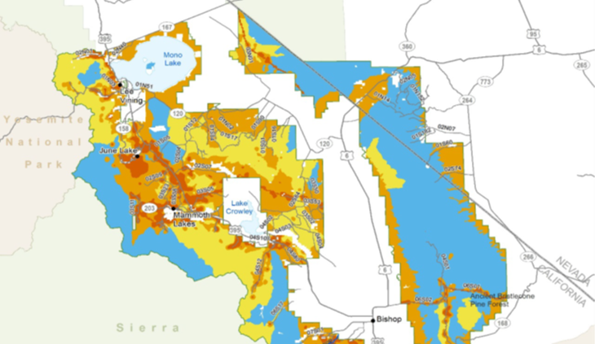
Inyo N.F. Strategic Fire Management Zones

Slide 14
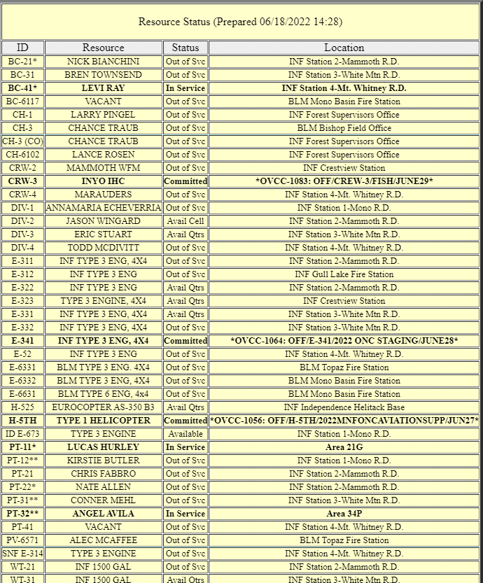
Planning for a Fire Response
-WHO?
-WHERE?
-WHAT?
-WHEN?
-HOW?
-WHY?

Slide 15
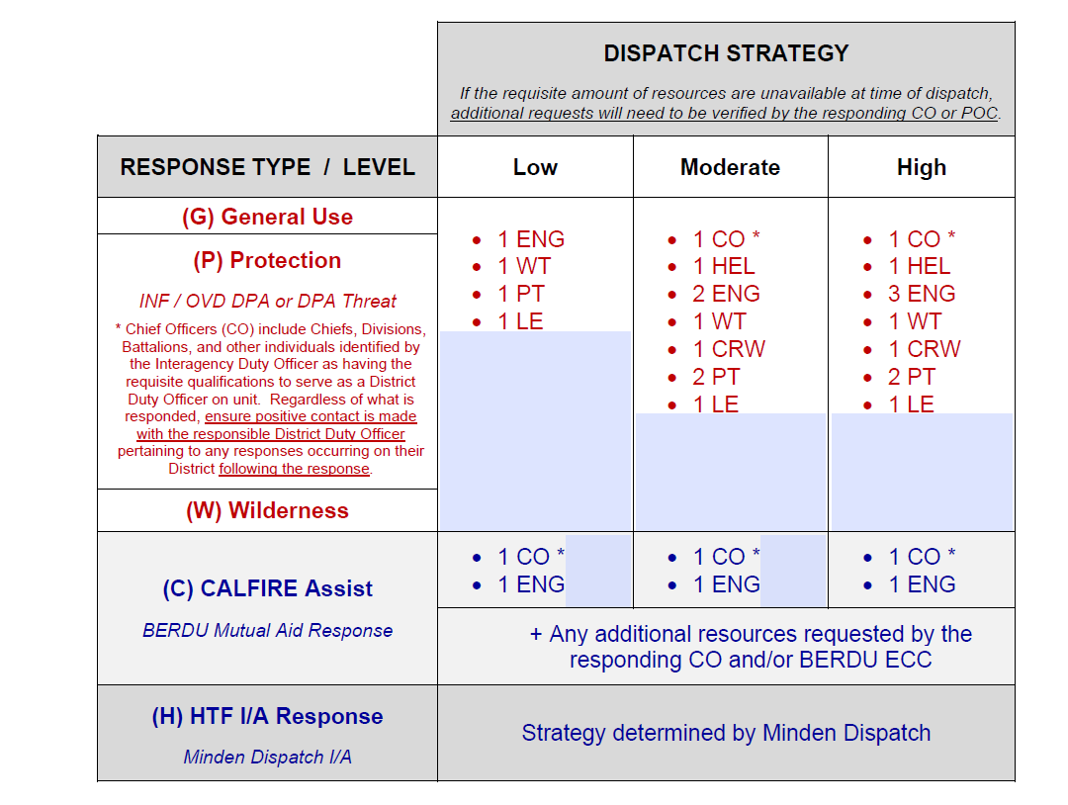
Dispatching Strategies

Slide 16
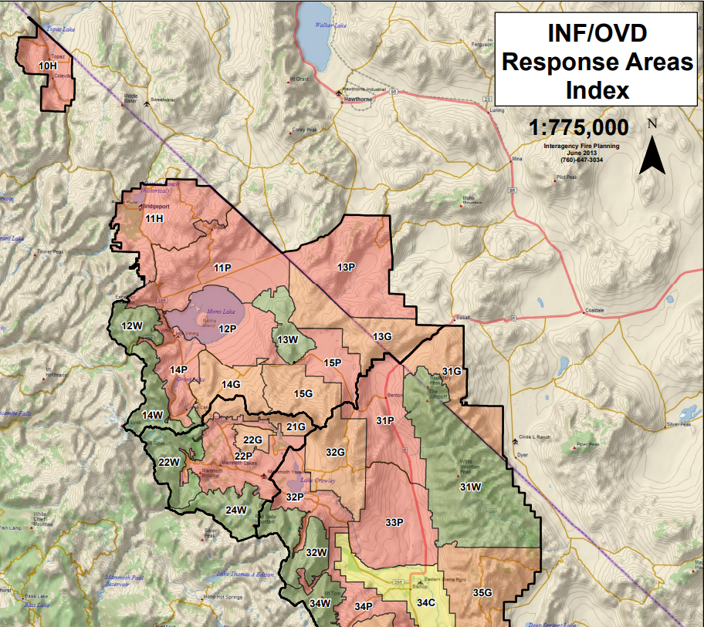
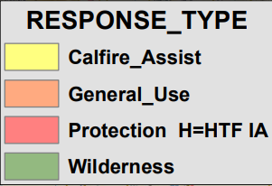
Response Map

Slide 17
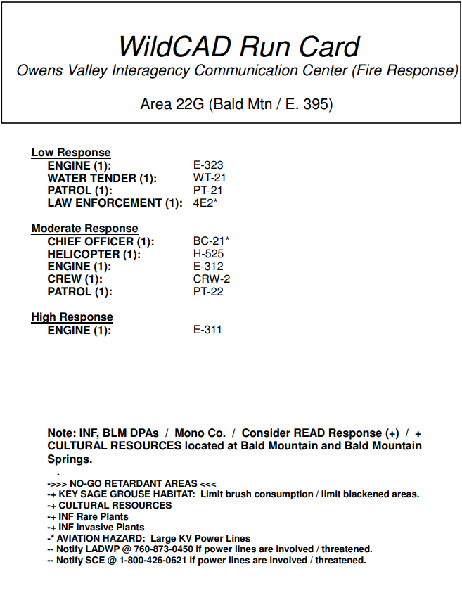
FIRE REPORTED!
!!!!EMERGENCY!!!!

Slide 18
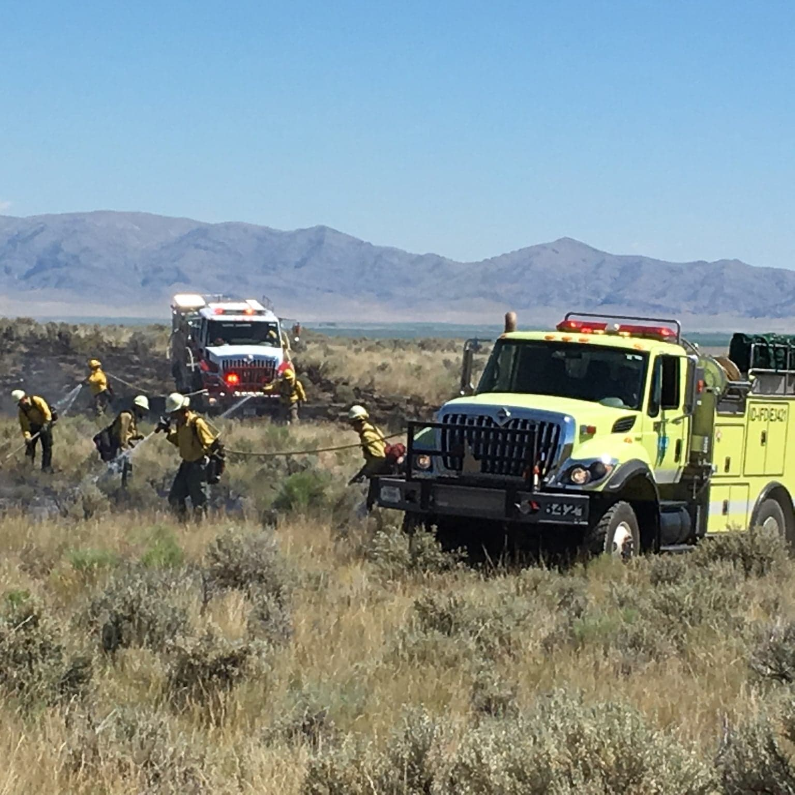
“ON SCENE”- now what?
Determine the Threat- People? Structures? Natural Resources?
Determine the Location- Ownership, Responsibility
Determine the Cause- Lightning vs. Human
Determine appropriate Management Strategy
- Suppression (Confine/Contain/Monitor)
- Manage for Resource Objectives
- or Both?

Slide 19
Process in Determining Management Strategy
Fire is threating Public Safety, Infrastructure, and/or Natural or Cultural Resources
YES
FULL SUPRESSION
No
Does the Agency have a pre-established Management Plan which allows managing wildfire for resource benefit in this location?
No
Yes
Could the landscape benefit from this fire?
No
Yes
Is there SUPPORT to allow some or all the fire to function in its natural ecological role?
No
Now What?
MAYBE???

Slide 20
Process in Determining Management Strategy (Cont.)
Safety
Risks
Benefits
Course of Action

Slide 21
To sustain the health, diversity, and productivity of the public lands for the use and enjoyment of present and future generations
To sustain the health, diversity, and productivity of the nation’s forests and grasslands to meet the needs of present and future generations.

